Slide 1
Samba KCC: Saying No to Full Mesh Replication
Garming Sam
Catalyst IT, Samba Team

Slide 2
History of the Samba KCC
KCC written in C
Dave Craft (2011)
Easy to debug your own bugs, not someone else
Late 2014 - Early 2015
Stable reproducible
Dot graph
Avert some of these bounces outside of KCC

Slide 3
What is the KCC?
Knowledge consistency checker
Used to manage replication connections in AD
Set of algorithms to produce efficient network topologies

Slide 4
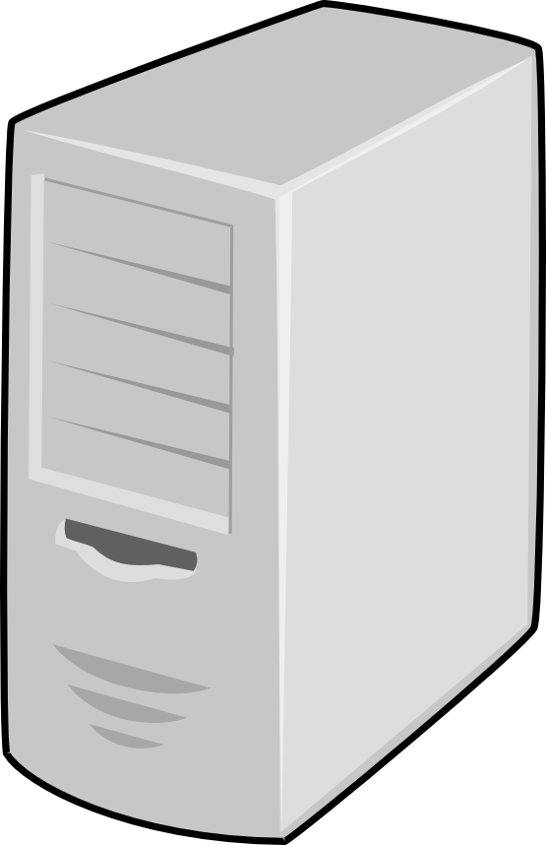
Intra-site algorithm
Ring topology, with a few extra connections

Slide 5
Inter-site algorithm
Site B
Site A
Site C
Site D

Slide 6
Inter-site algorithm
Site B
Site A
Site C
Site D

Slide 7
Inter-site algorithm
Stable answer across entire DC network

Slide 8
Remove unneeded connections
Stable answer across entire DC network
Used to manage replication connections in AD
Set of algorithms to calculate efficient network topologies

Slide 9
Translate connections
Stable answer across entire DC network
Used to manage replication connections in AD
Set of algorithms to calculate efficient network topologies

Slide 10
With Samba 4.5, the new site-aware Samba Knowledge Consistency Checker (KCC) has been turned on by default. Instead of using full mesh replication between every DC, the KCC will set up connections to optimize replication latency and cost (using site links to calculate the routes). Although there is more effort required in establishing effective site topologies, it has enabled users to create larger and more distributed networks without any of the previous replication penalties. It has also meant that Samba AD can be aware of particular details of a network (such as satellite links or certain firewall restrictions) to ensure that information flows through the network in a reasonable way. The aim is to look at how sites in AD generally work, what role the KCC performs, and what implications this new feature has on a range of different networks.

Slide 11

Hyperedge and hypergraphs

Slide 12
Internal consitencies, it's hard to say what actually needs to be corrected.

Slide 13
2637 # Step 1
2638 self.refresh_failed_links_connections(ping)
2640 # Step 2
2641 self.intrasite()
2643 # Step 3
2644 all_connected = self.intersite(ping) # overlay a failed network ontop of the expected
2646 # Step 4
2647 self.remove_unneeded_ntdsconn(all_connected)
2649 # Step 5
2650 self.translate_ntdsconn()
2652 # Step 6
2653 self.remove_unneeded_failed_links_connections()
2655 # Step 7
2656 self.update_rodc_connection()

Slide 14
i1929 The KCC does not create more than 50 edges directed to a
1930 single DC. To optimize replication, we compute that each node
1931 should have n+2 total edges directed to it such that (n) is
1932 the smallest non-negative integer satisfying
1933 (node_count <= 2*(n*n) + 6*n + 7)

Slide 15
Select ITSG
1140 An intersite graph has a Vertex for each site object, a
1141 MultiEdge for each SiteLink object, and a MutliEdgeSet for
1142 each siteLinkBridge object (or implied siteLinkBridge). It
1143 reflects the intersite topology in a slightly more abstract
1144 graph form.

Slide 16
White, red black color vertex

